Slide 1
Similarity of the top 100 cities in US based on their venues style
Zimu Guo

Slide 2
How can I find my favorite city?
The United States is a diverse country where you can find almost all possible kinds of entertainments. Someone may like to know the best destination where the venues would fit one’s appetite.
Data that might contribute to determining similarity between cities based on the categories of venues: The project aim to divide the top 100 cities (based on population) in several groups based on data. If one loves feels good in a city, then he or she would also enjoy his or her life in the cities which are in the same group of the previous one.

Slide 3
Data Might Help
Necessary Data
The top 100 cities in US based on population
The venues in each city and their categories
Data Source
Wikipedia: “List of United States cities by population”
Data on FOURSQUARE

Slide 4
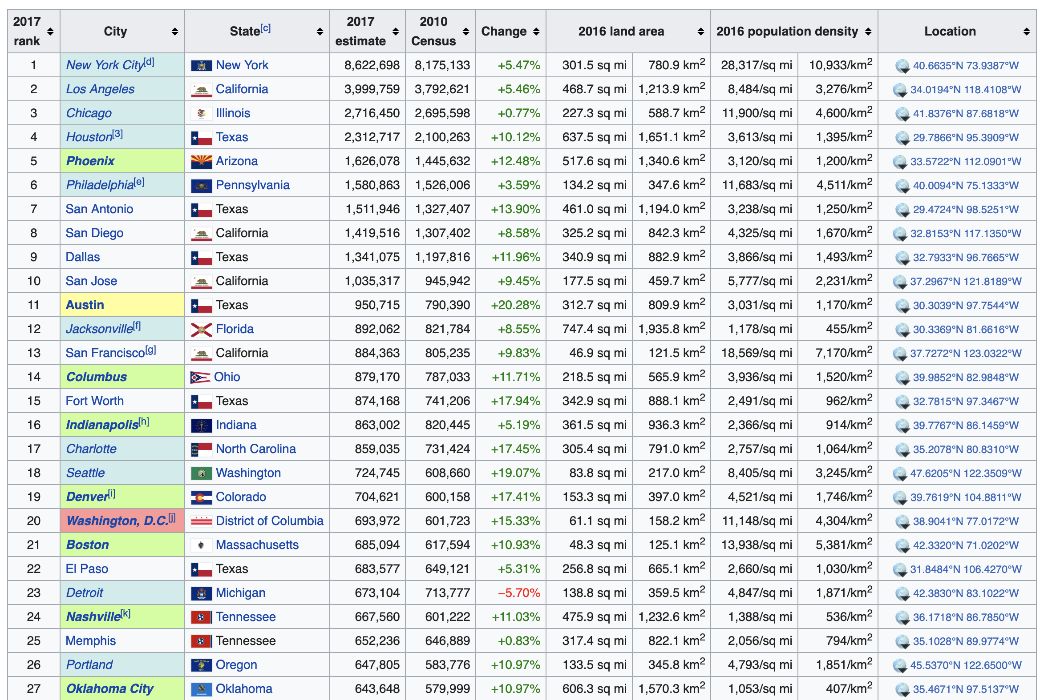
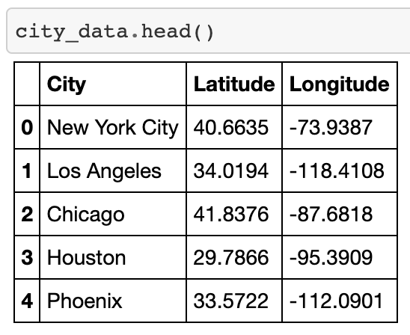
Retrieve Data From wikipedia

Slide 5
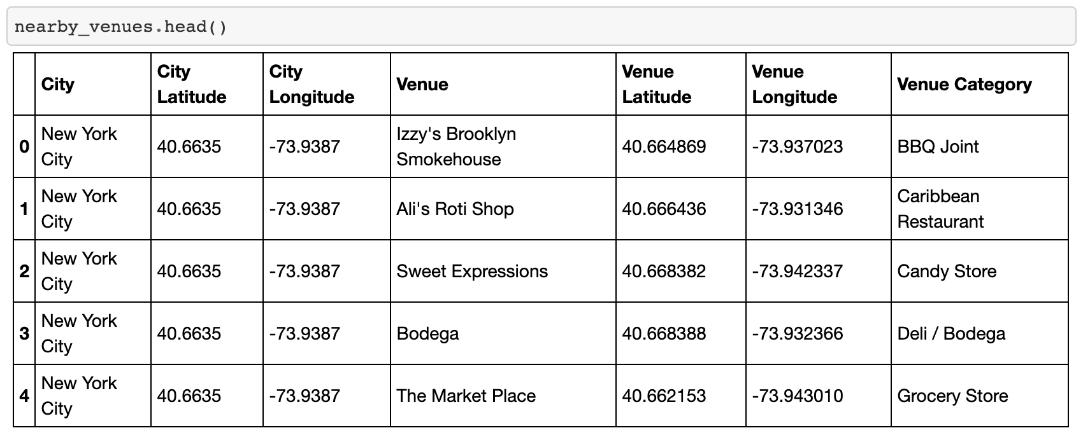
Get Data From Foursquare

Slide 6
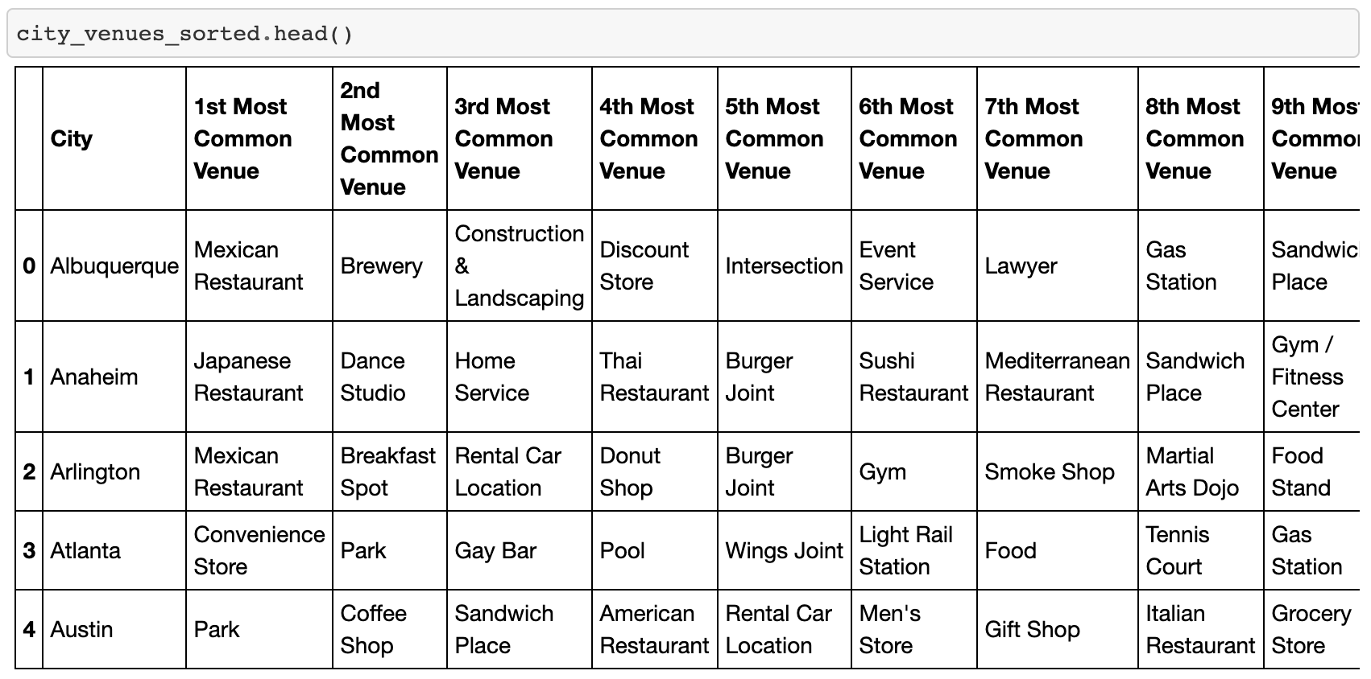
find the 10 most common venues in each city

Slide 7
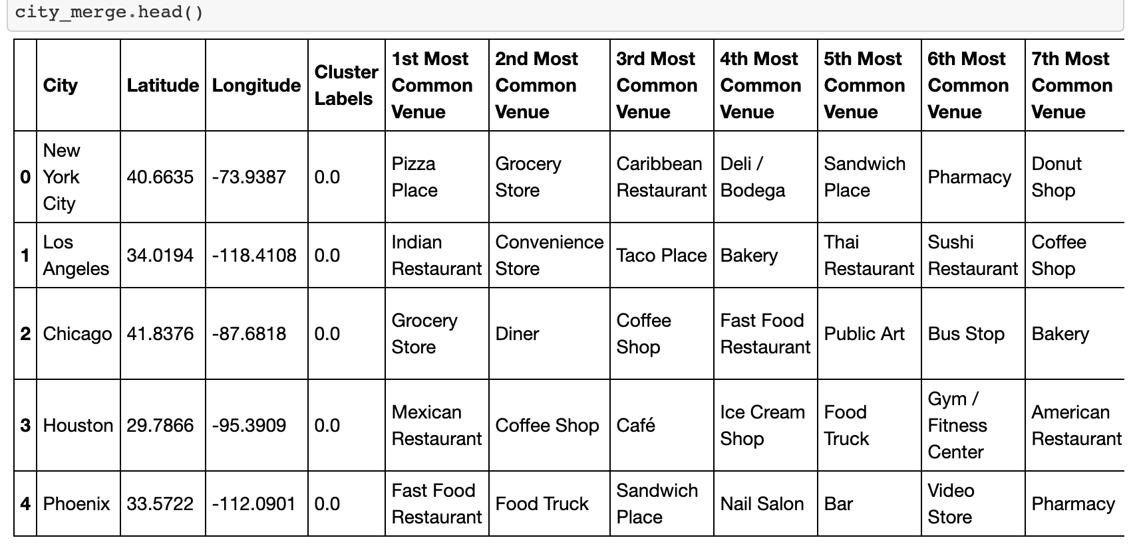
Merge the position and venues information for each city and

Slide 8
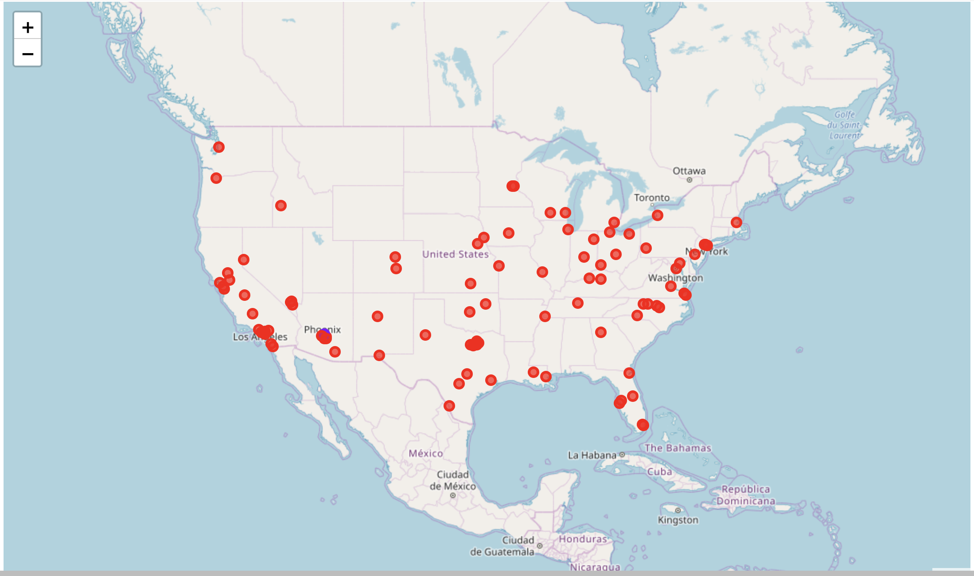
Clustering K-means k=2

Slide 9

Clustering k-means with k=3

Slide 10
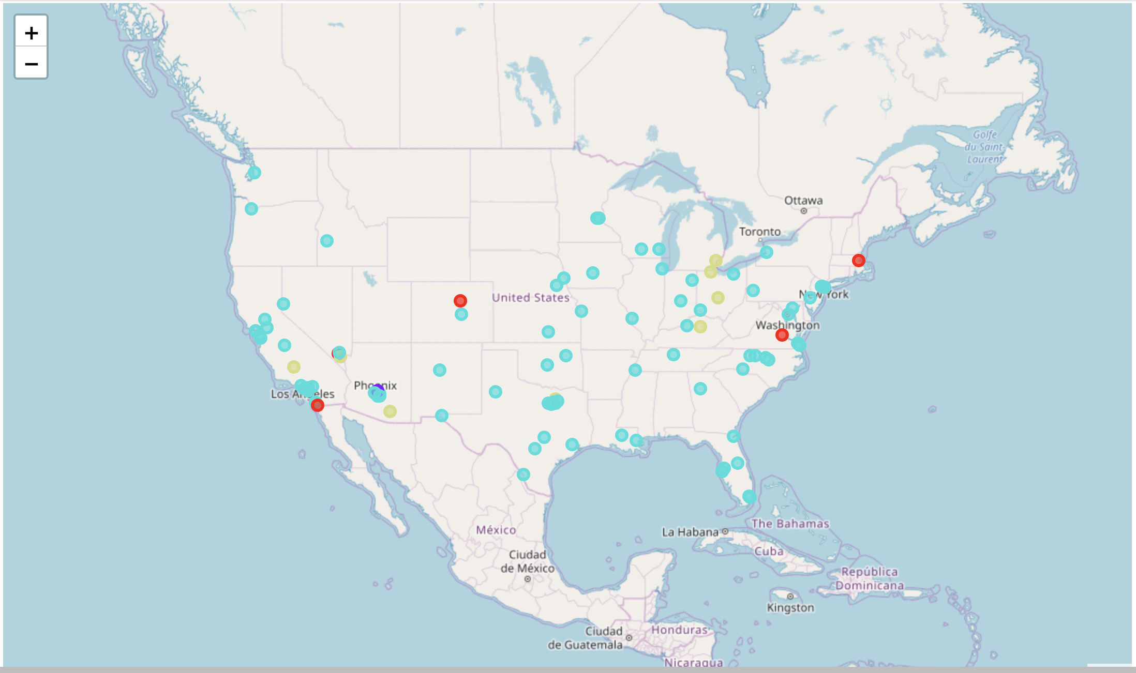
Clustering k-means k=4

Slide 11

Clustering k-means k=5

Slide 12
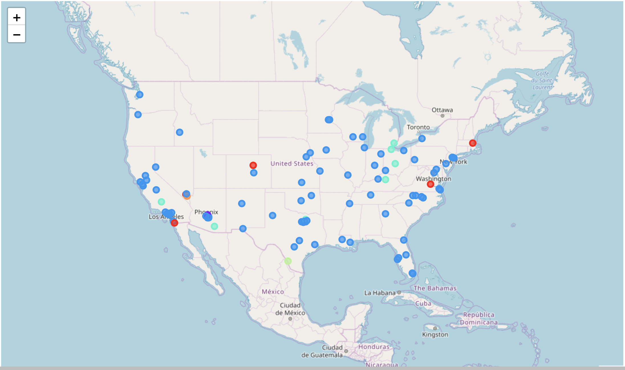
Clustering k-means k=6

Slide 13
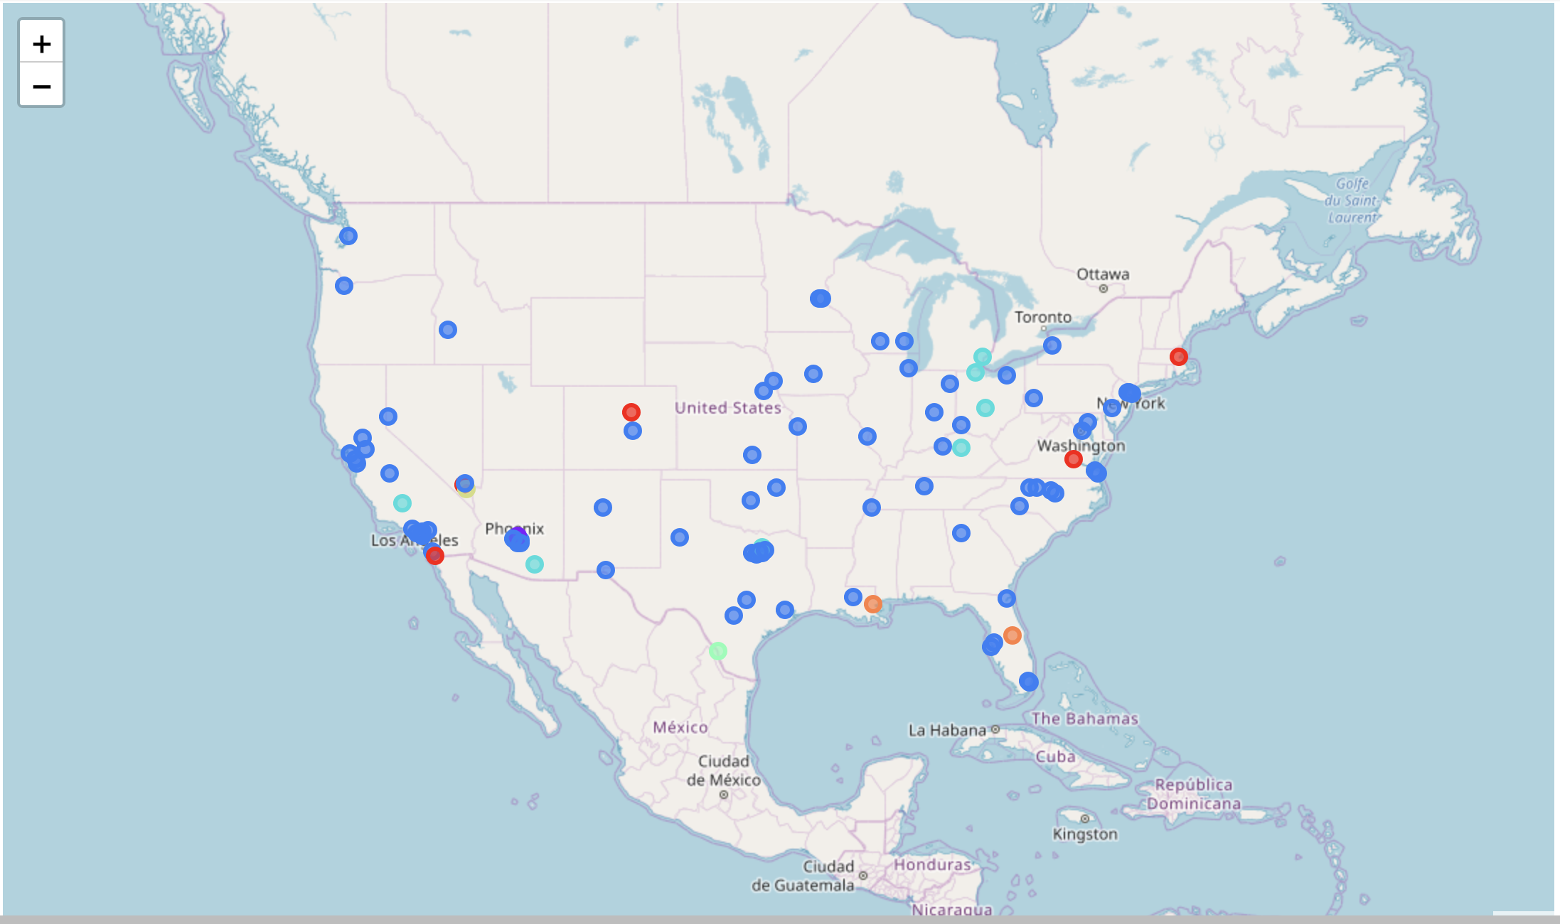
Clustering k-means k=7

Slide 14
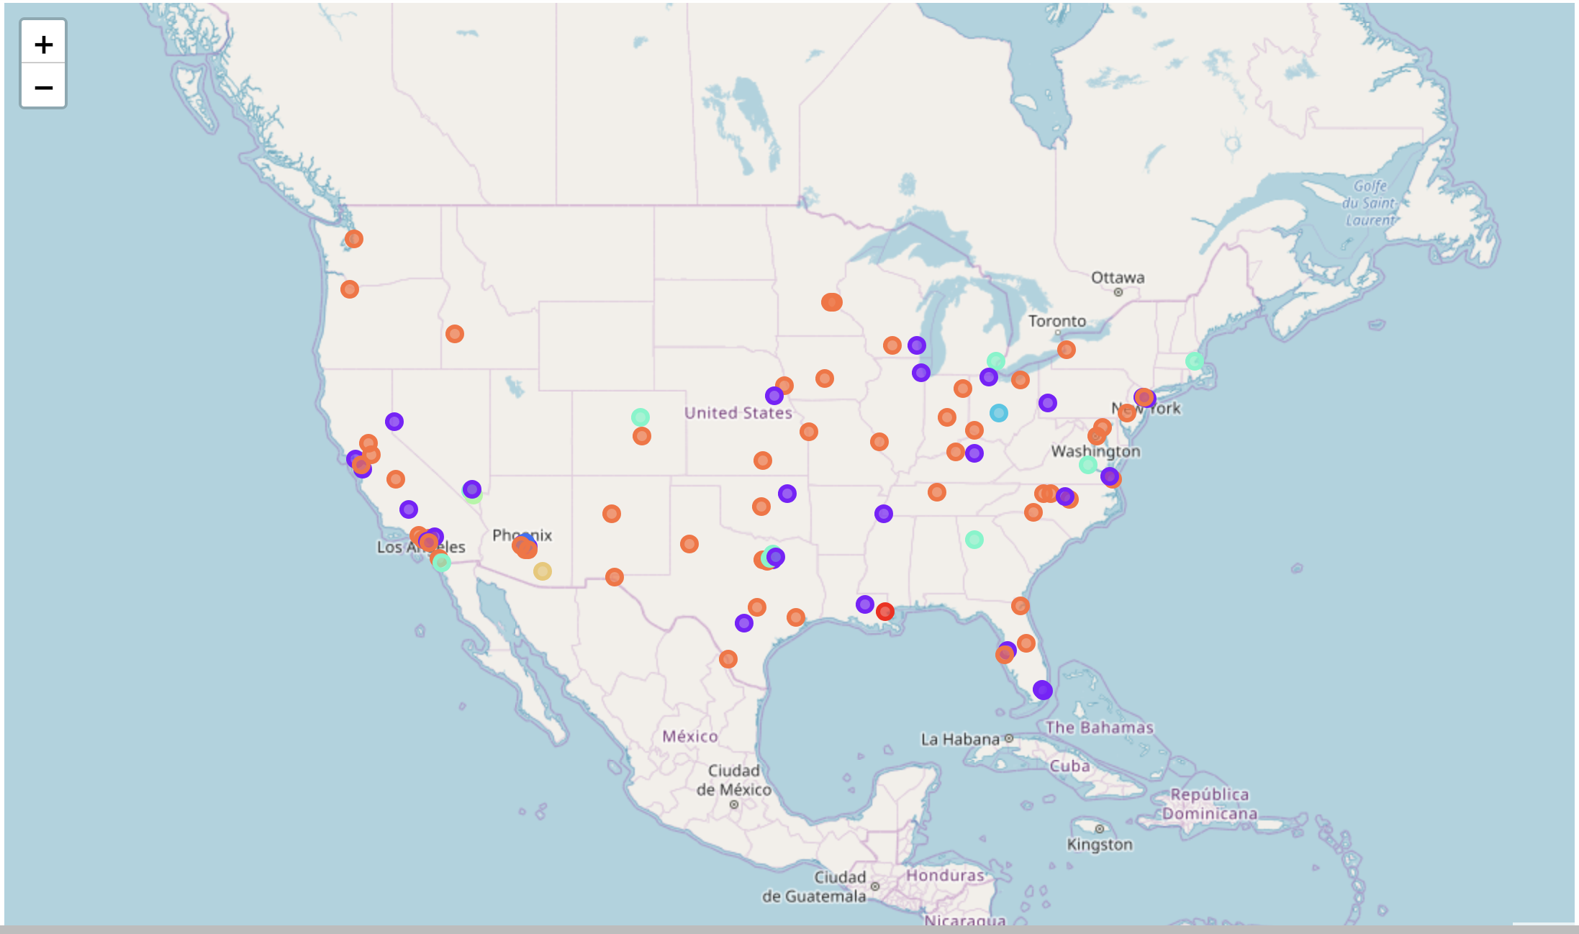
Clustering k-means k=8

Slide 15

Clustering k-means k=9

Slide 16
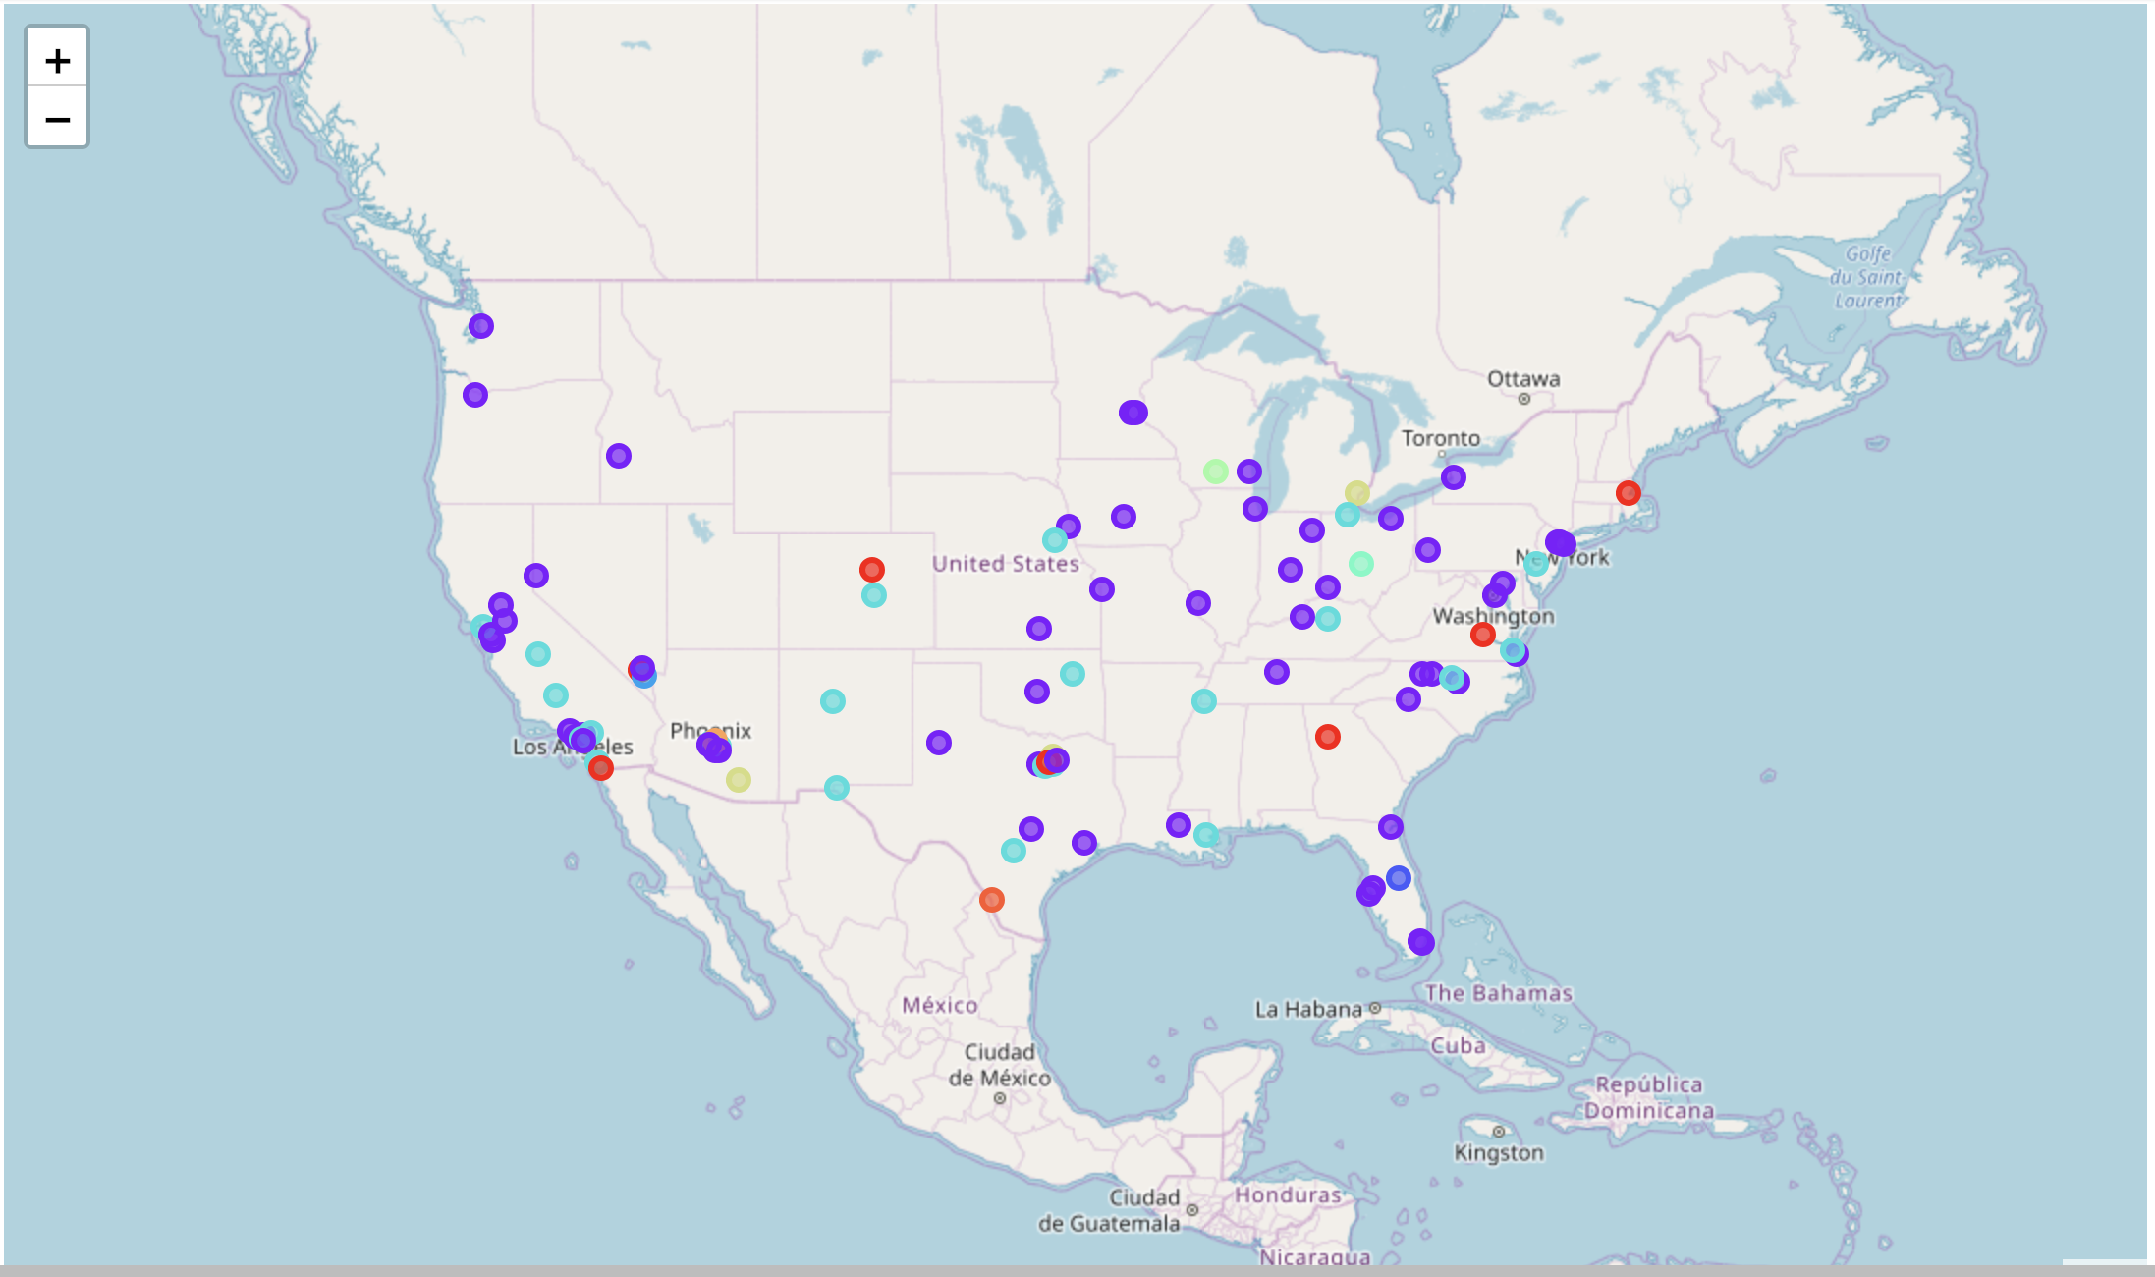
Clustering k-means k=10

Slide 17
Observations on the maps
We didn’t see any boundary such as splitting north and south, or east and west whatever the value of k is.
We didn’t find same color of points are intended to be closer to each other.
Therefore, the points are distributed more like randomly, which means we can neither say that you will like the city nearby your favorite region, nor the west coast or the east area would be your best choice.

Slide 18

conclusion
The points in same color, i.e. the cities in same cluster, are similar to each other based on the categories of venues.
Therefore, if you have a favorite city and given the maps above, then you can simply look up the maps and find the similar cities you would love.

